Slide 1
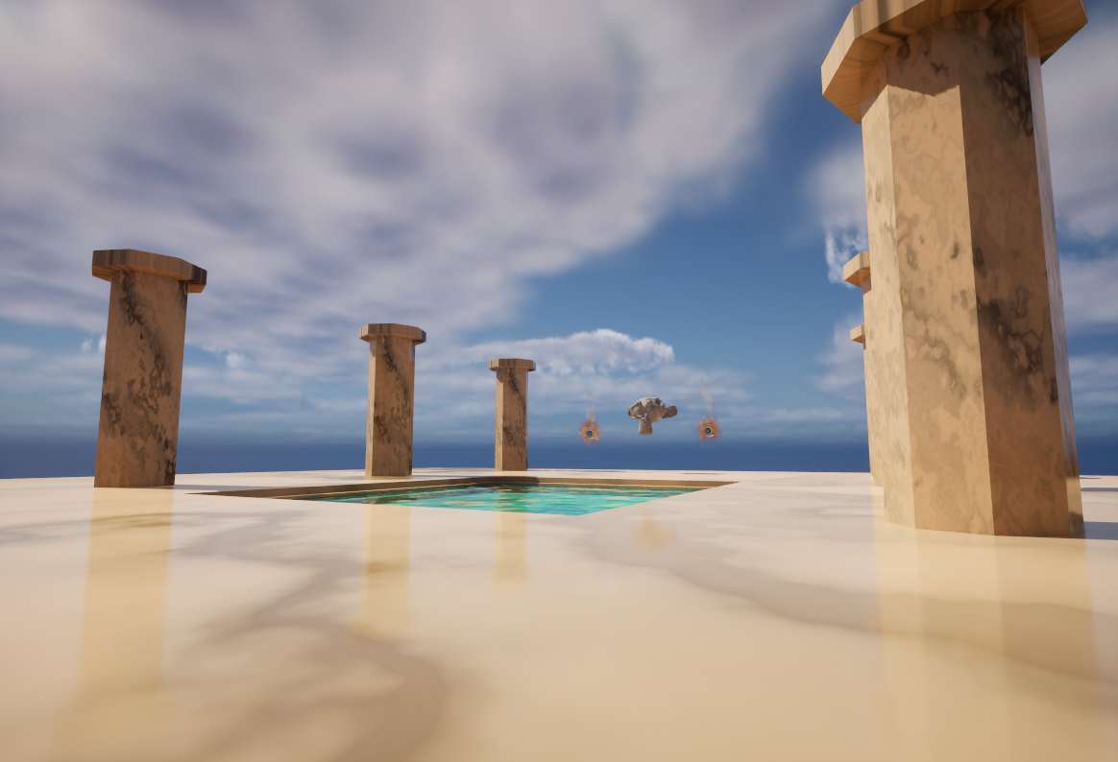
Marble Temple of Suzanne
Kirk Hogden
001115381

Slide 2
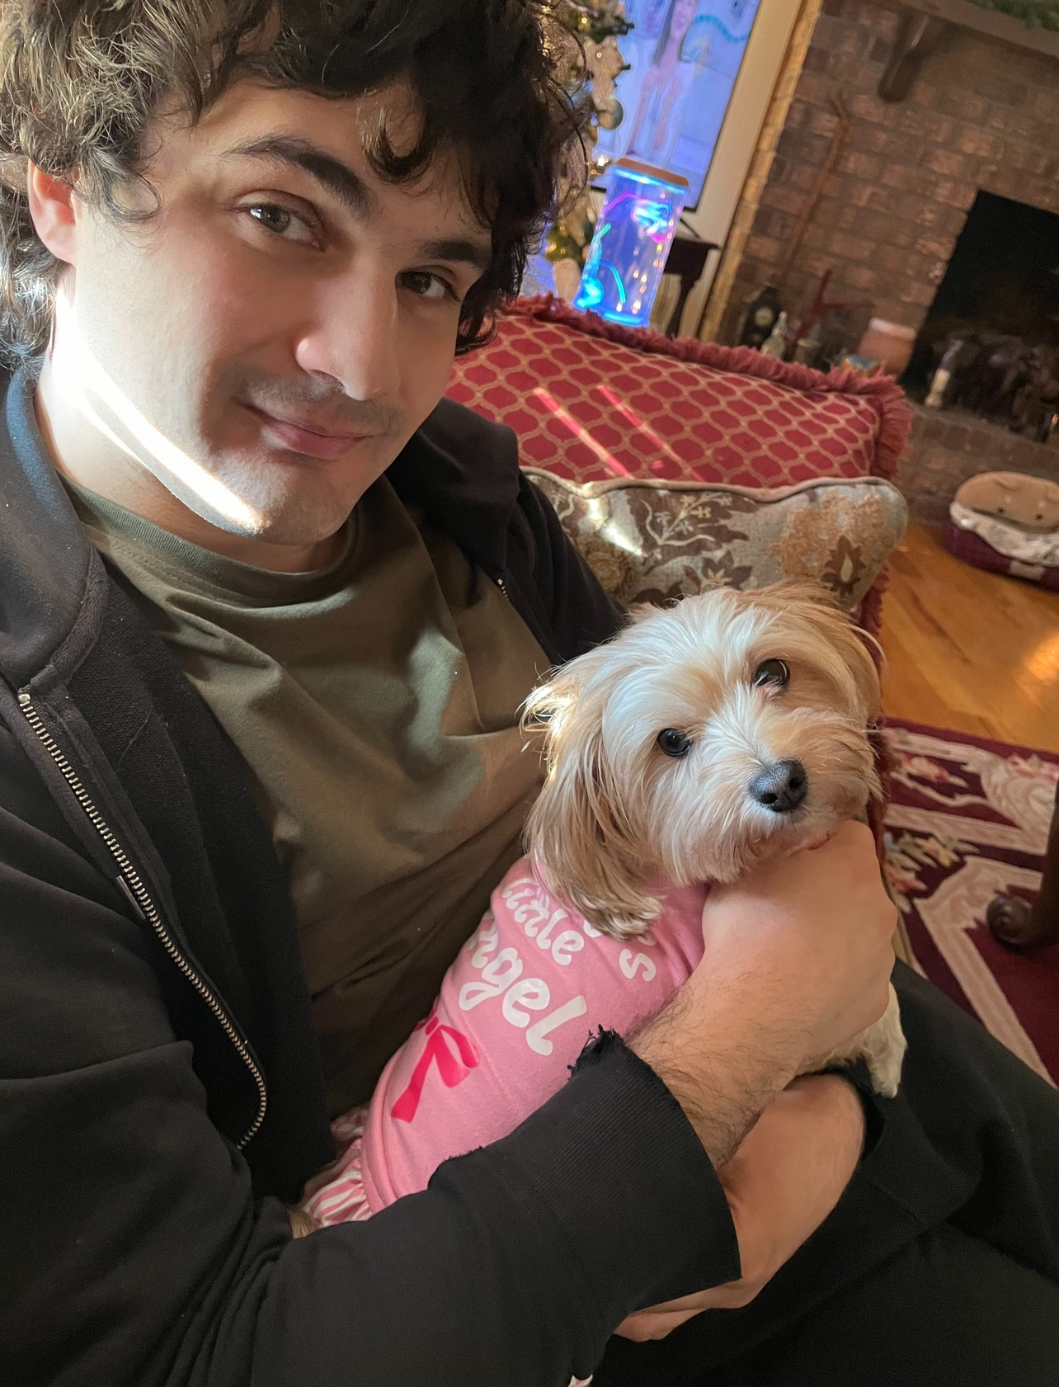
Kirk Hogden
I am Kirk Andrew-Raymond Hogden.
Since 2014 I have been using Unity.
Game development has been my interest since I was a kid.
I enjoy developing personal game projects outside of university.

Slide 3
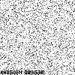
INSPIRATION
During week four, the lab tasks taught students how to make a distorted mesh shader through using the noise node.
The noise node in Unreal Engine 5 however, takes up a lot of performance which isn’t good for games running real-time.
I took it on myself to learn further and see how performance could be reduced, while making pleasing designs with the feature.
I also have a fascination for noise in games!

Slide 4
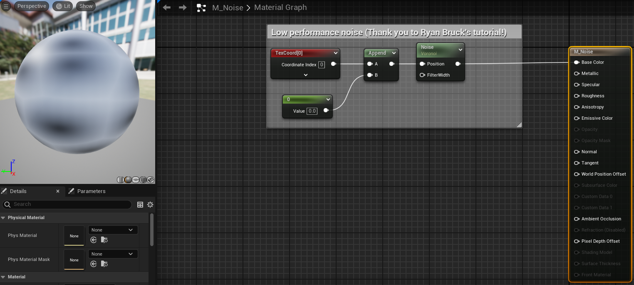
SHADER DEVELOPMENT – MARBLE 1/3
Before creating the marble shader, a base shader was created. This shader could be duplicated from, so that any noise-related shaders I make can all avoid using too much performance.
The appearance of this base shader allowed for different creative potentials on what to make with Voroni noise, such as a marble texture!
Brucks, R. (2016). Getting the Most Out of Noise in UE4. [online] Unreal Engine. Available at: https://www.unrealengine.com/en-US/tech-blog/getting-the-most-out-of-noise-in-ue4.

Slide 5
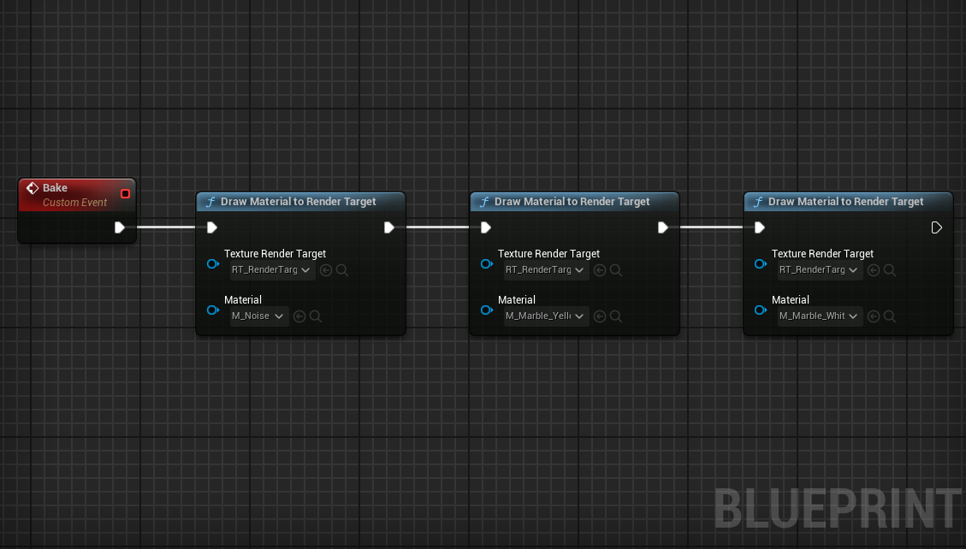
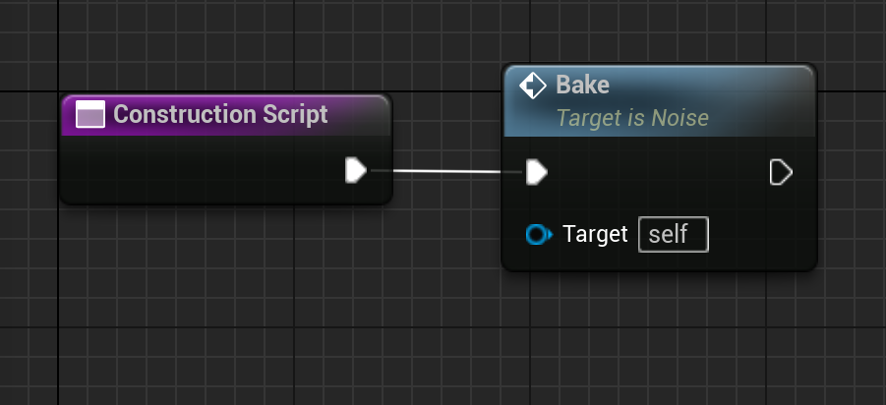
SHADER DEVELOPMENT – MARBLE 2/3
An actor blueprint class was created alongside a render target. The purpose of this is to have the noise shader be baked onto the render target.
I would come back to this actor every time I duplicated the noise shaders, making sure the duplicates are included within the event graph too.
Baking the shaders help with rendering performance.
Brucks, R. (2016). Getting the Most Out of Noise in UE4. [online] Unreal Engine. Available at: https://www.unrealengine.com/en-US/tech-blog/getting-the-most-out-of-noise-in-ue4.

Slide 6
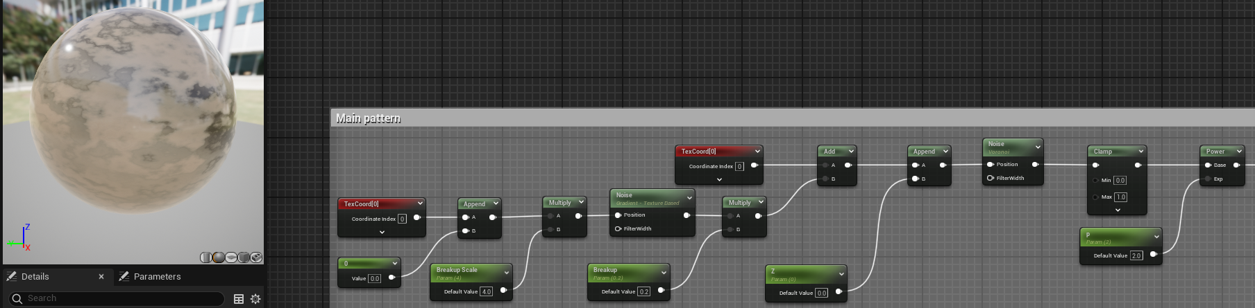
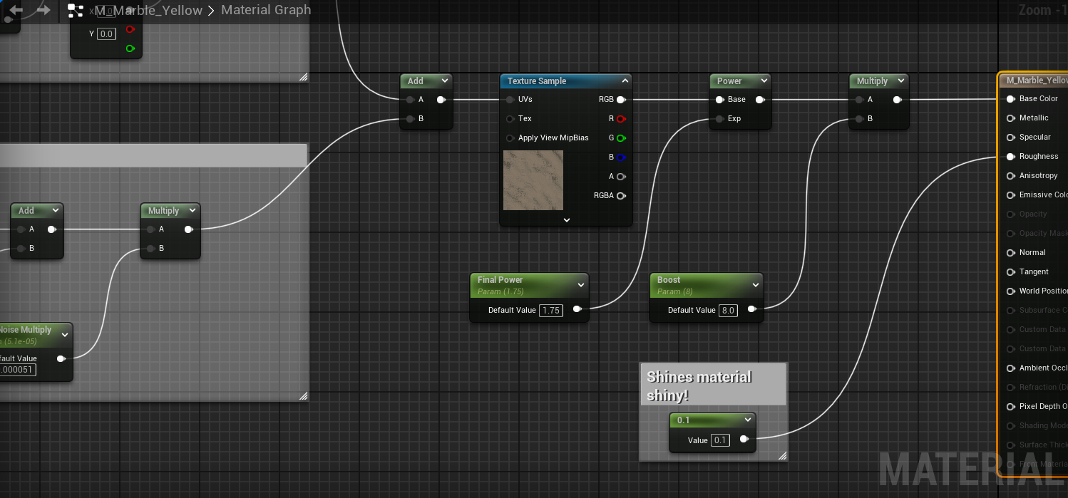
SHADER DEVELOPMENT – MARBLE 3/3
With the base Voroni noise shader setup, I duplicated that material and created a marble pattern with the help of an additional Gradient noise node.
The Gradient noise node is multiplied by 0.2 before being added with the Voroni noise. Using a texture sample node afterwards allows for giving colour to the shader.
Although this shader was made through the help of Ryan Bruck’s article, I made my own addition by making the marble texture reflective. Marble tends to have some form of shininess, so it made sense.
Brucks, R. (2016). Getting the Most Out of Noise in UE4. [online] Unreal Engine. Available at: https://www.unrealengine.com/en-US/tech-blog/getting-the-most-out-of-noise-in-ue4.

Slide 7
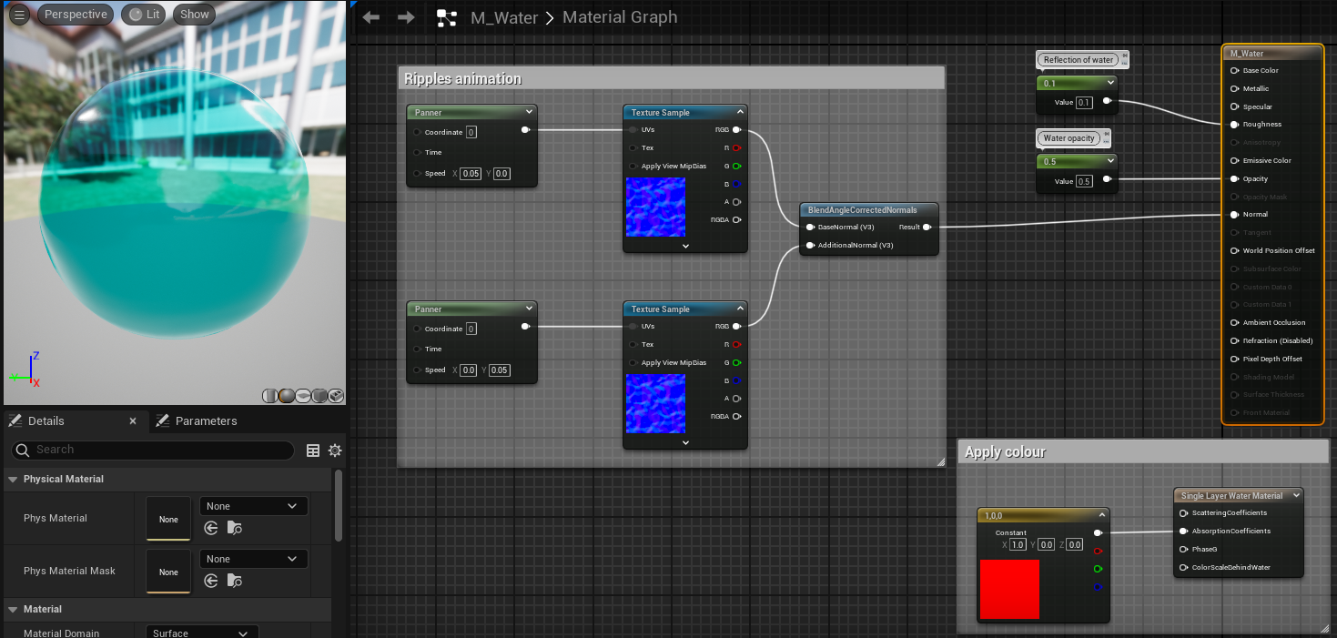
SHADER DEVELOPMENT – SIMPLE WATER
To complement the marble shader, an additional water shader was created to give a liquid theme for level.
Because water is constantly rippling, a ripple animation was created by using two panner nodes, alongside texture sample nodes for the ripple textures. One panner would be used to have ripples moving horizontally, while the other flows vertically.
A Constant3Vector applies colour to the shader by sending the results into a Single Layer Water Material.
Two constant nodes are used to give transparency to the shader, alongside making it reflective.

Slide 8
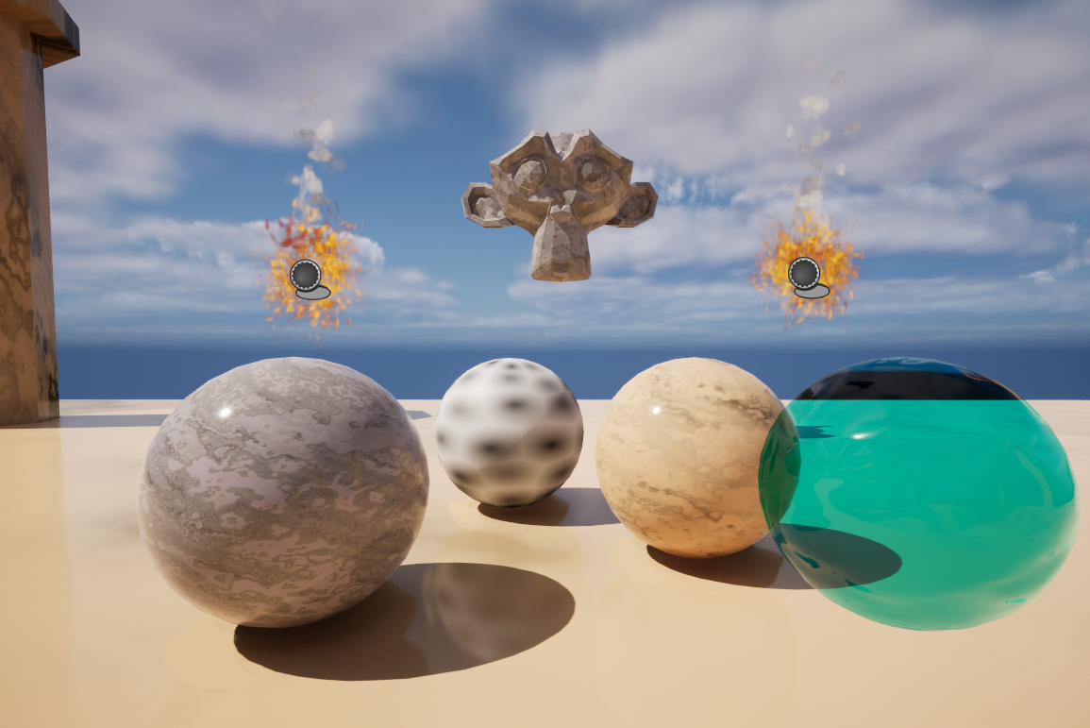
SHADER CLOSE UPS
Close up examples.

Slide 9
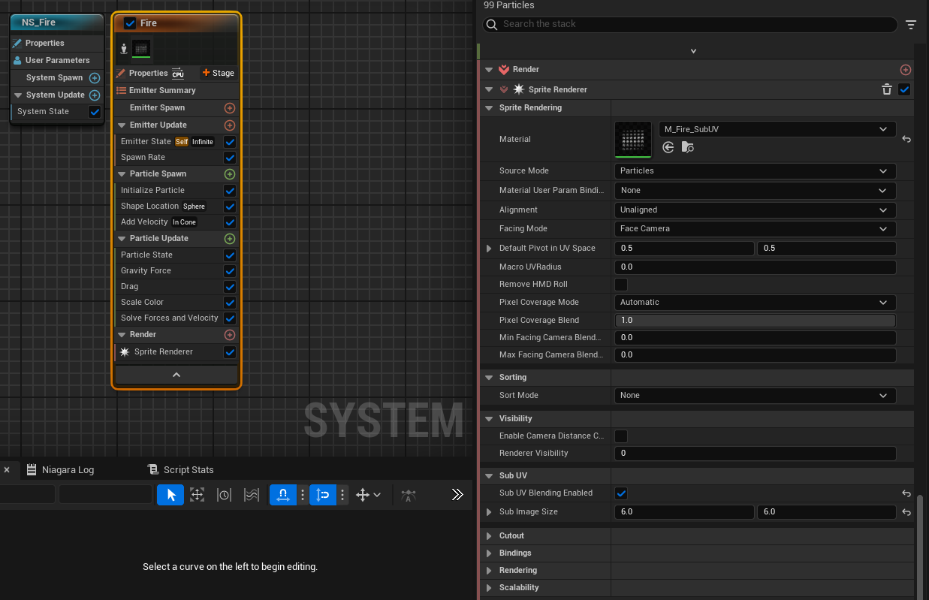
PARTICLE SYSTEMS 1/2
Because I’ve had experience making simple fire particles in prior modules within Unity, I wanted to pass down that knowledge and see if I could recreate it in Unreal Engine 5 too.
When setting up the Niagara system, the fountain template made most sense as fire flows upwards.
For realism, some particles spawned orange while others leaning towards red. The velocity was slowed down greatly to give the flame a gentle flow.
Some parts took me a while to understand. I used Unreal Engine’s default fire texture, which comes with multiple sprites on one sheet. Through using a tutorial, I learnt that enabling the sub UV blending setting and adjusting the sub image size values allows each sprite on the sheet appear by themselves.

Slide 10
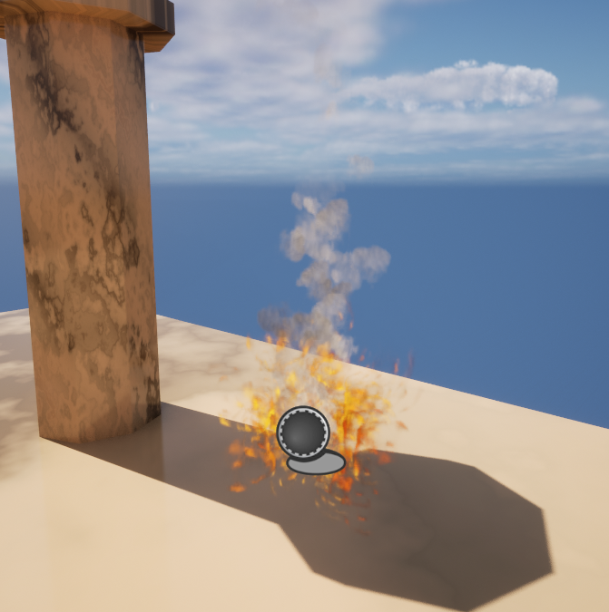
PARTICLE SYSTEMS 2/2
Duplicating the fire Niagara system, smoke particles were also created with their settings adjusted.
The sprites for the smoke particles were swapped, and the velocity was slightly increased to make sure they would travel above the fire.
Some smoke particles would appear a lighter grey, whereas others leaning to a darker tone.
Using a cone shape for particles to emit from, this helps the smoke particles to spread across the sky, as smoke usually would in the real world.
To make these particles collaborate in levels, an actor blueprint was created where they would be placed into.

Slide 11
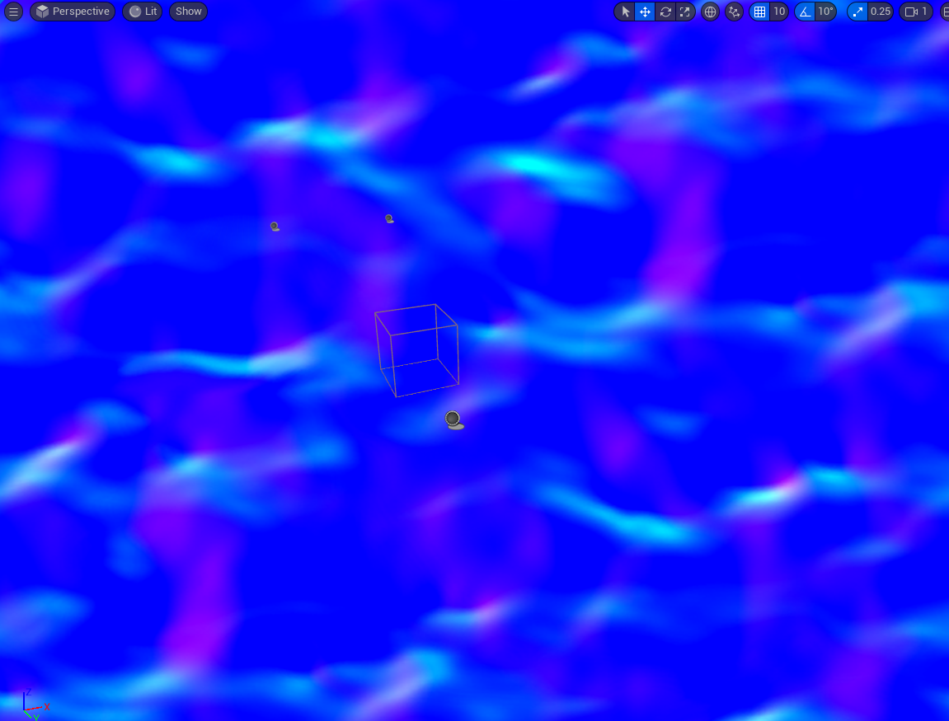
POST PROCESSING
By duplicating the prior water shader, it was converted into a post processing shader from the material domain and instead connected to the master node’s Emissive Color plug.
To apply it into the level, a post processing volume instance was created, using infinite extent. An instance of the material afterwards was added to the post process materials array.
The inspiration for this image effect came from week nine’s lab task. I wanted to use my own water shader instead, however I couldn’t figure out how to apply opacity to it.
It helps to give a water-like theme for the marble temple level!

Slide 12
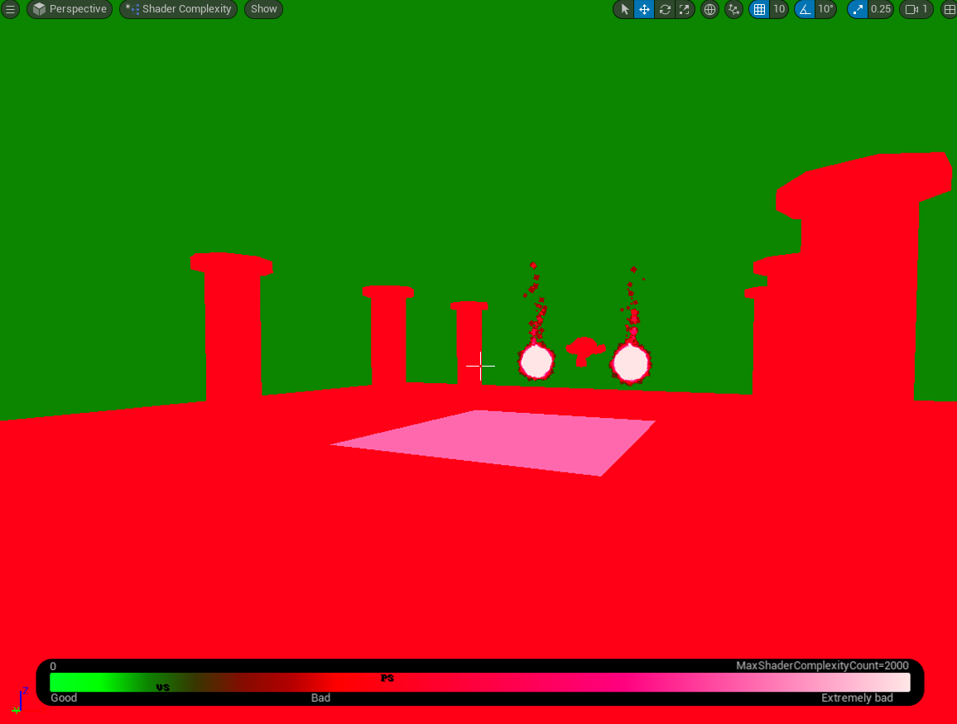
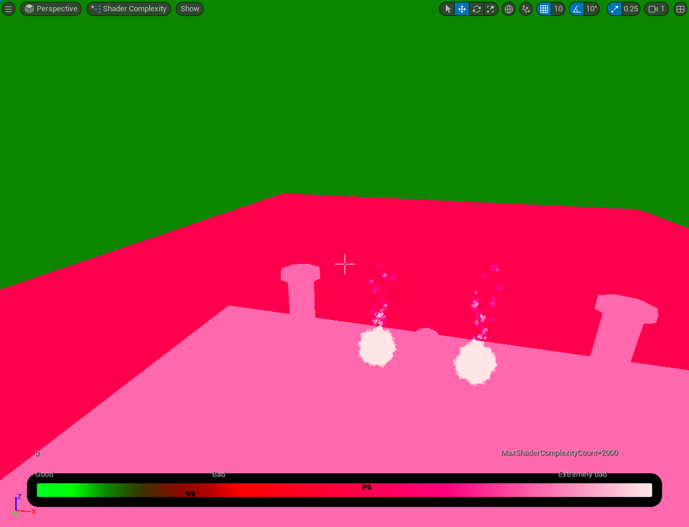
BENCHMARKING/SHADER OPTIMISATION 1/2
The shader complexity tool was used to discover what graphics were used the most performance.
When in this viewport, all the shaders appeared to be red. The water shader being transparent while in front of the marble shader shows pink.
To see the water shader appear red was strange, considering the simplicity.

Slide 13
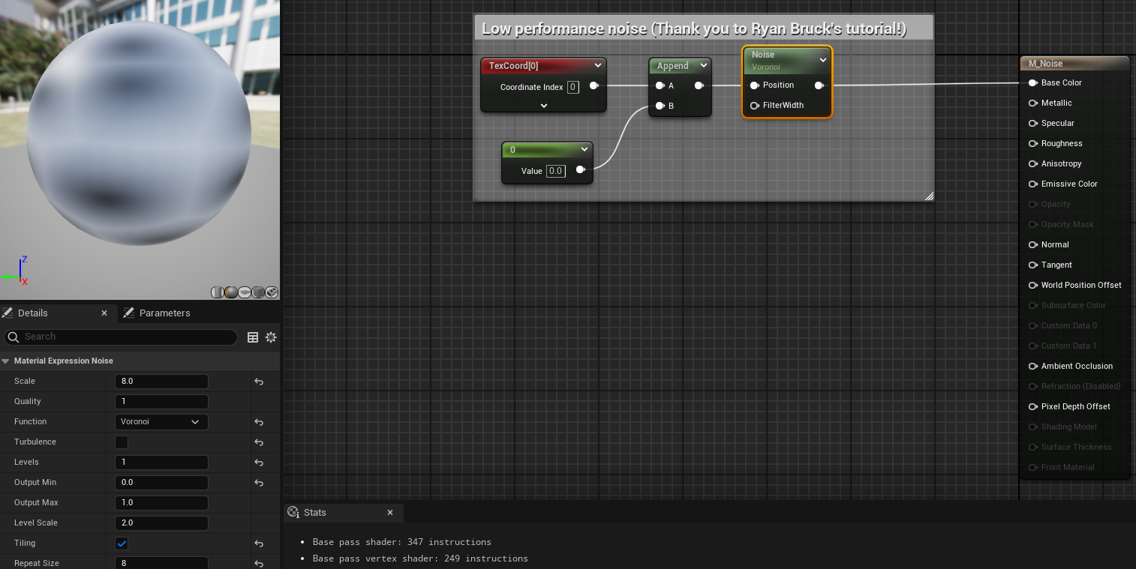
BENCHMARKING/SHADER OPTIMISATION 2/2
As mentioned in prior slides, noise-related shaders took extra steps to make sure performance didn’t get used up too much.
Noise nodes in Unreal Engine 5 are known to consume performance heavily.
Outside of shaders, both the fire and smoke particles tend to emit just above one hundred particles at a time.
Ezbench Solutions AS (2022). EzBench Benchmark on Steam. [online] store.steampowered.com. Available at: https://store.steampowered.com/app/770170/EzBench_Benchmark/ .

Slide 14
DEMO VIDEO
https://drive.google.com/file/d/189S__gQ-u0D1IZf7griGEn_uhZAkZEMY/view?usp=sharing

Slide 15
REFLECTION
Even though the marble texture was created uniquely through Voroni and Gradient noise, it may be more efficient to simply create a material and apply a marble image texture instead. It would make more sense to use noise on shaders that are animated, in which static textures cannot imitate.
An interesting idea considering that the shader uses noise, perhaps a seed value could be used to make the same marble pattern appear random for each object the material is applied to.
To further assist with optimising shaders, it could be worth looking into EzBench. This tool allows developers with graphics related tasks.
Being unfamiliar with Unreal Engine, it was hard to tell if seeing all the shaders appear red in the Shader Complexity viewport was normal or not. It may be because of other graphics-related settings rather than the shaders themselves.

Slide 16
REFERENCES
Brucks, R. (2016). Getting the Most Out of Noise in UE4. [online] Unreal Engine. Available at: https://www.unrealengine.com/en-US/tech-blog/getting-the-most-out-of-noise-in-ue4.
Ezbench Solutions AS (2022). EzBench Benchmark on Steam. [online] store.steampowered.com. Available at: https://store.steampowered.com/app/770170/EzBench_Benchmark/ .
Citations generated from mybib.com

Slide 17
APPENDIX A
Fire particles tutorial, Hell FX Learn, YouTube, 2023, https://youtu.be/q8avHL7syC4?si=qHH9x-n-vLGL4Dwr
Getting the Most Out of Noise, Ryan Brucks, UnrealEngine.com, 2016, https://www.unrealengine.com/en-US/tech-blog/getting-the-most-out-of-noise-in-ue4
Simple water material tutorial, Gorka Games, YouTube, 2023, https://youtu.be/o6f7n4UhYq0?si=ovdcwld_7cYhKfSO

Slide 18
THANK YOU (LAST SLIDE)
Thank you, Chris for teaching and leading this module. I have greatly enjoyed learning shader programming and it is something I would love to get the hang of more in my game projects outside of university.
This module has been an enjoyable experience for my final year and term for university before my school life comes to an end.

